Slide 1
Security
Year 13

Slide 2

Objectives
At the end of the lesson students should be able to
Define the term encryption
State the purpose of encryption
Describe the two types of encryption keys
Describe what is a digital signature
Explain in detail the concepts of digital certificate
Describe Quantum cryptography
Explain how SSL/TLS works

Slide 3
Objectives
There are a number of security concerns relating to a transmission.
Confidentiality: Only the intended recipient should be able to decrypt the ciphertext.
Authenticity: The receiver must be certain who sent the ciphertext.
Integrity: The ciphertext must not be modified during transmission.
Non-repudiation: Neither sender nor receiver should be able to deny involvement in the transmission.
Availability: Nothing should happen to prevent the receiver from receiving the transmissions

Slide 4
Encryption
Year 13

Slide 5

Encryption
Process of converting readable data into unreadable characters so that only authorized parties can read or access the data
The unencrypted, readable text is called-plaintext. The encrypted (scrambled) data is called cipher text.
It uses complex algorithms to scramble the data being sent.
The security effectiveness is determined by the strength of the algorithm and the length of the key.

Slide 6

Encryption makes information unreadable to an unauthorized party therefore the information remains private and confidential, whether being transmitted or stored on a system.
Unauthorized parties will see nothing but an unorganized assembly of bytes.
Encryption technology can provide assurance of data integrity as some algorithms offer protection against forgery and tampering.
The ability of the technology to protect the information requires that the encryption and decryption keys be properly managed by authorized parties.

Slide 7

Two Types of Encryption
Private key also called Symmetric Key Encryption
Is a secret key which can be a combination of characters. If this key is applied to a message its contents is changed which makes it unreadable unless the recipient also has the decryption key.
One key is needed to encrypt a message and the same key is needed to decrypt a message. The sender and the receiver should have the same encryption and decryption key

Slide 8
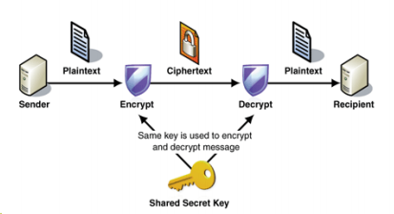
Two types of Encryption
Private key also called Symmetric Key Encryption
Both the originator and the recipient use the same secret key to encrypt and decrypt the data.
One key is needed to encrypt a message and same key is needed to decrypt a message.
It is obviously important that the sender and receiver have the same encryption and decryption key.
Key distribution is a security problem The sender has to supply the key to the recipient which can be intercepted by a hacker

Slide 9
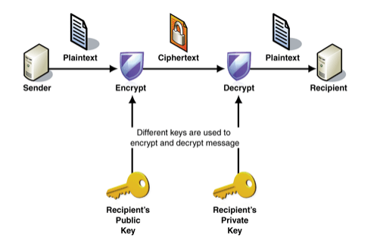
Public key Encryption, also called Asymmetric key
Uses two encryption keys: a public key and a private key.
Public key encryption software generates both the private key and the public key.
A message encrypted with a public key can be decrypted only with the corresponding private key, and vice versa.
The public key is made known to message originators and recipients but the private key is only known by the computer user.

Slide 10
Public key Encryption, also called Asymmetric key
Using the asymmetric key encryption , the process starts with the receiver. The receiver must be in passion of two keys. One is a public key which is not secret. The other is a private key which is secret and only known to the receiver.
The receiver can send the public key to a sender, who uses the public key for encryption and sends the cipher text to the receiver
The receiver is the only person who can decrypt the message because the private and public keys are matched pair.
The public key can be provided to any number of different people allowing the receiver to receive a private massage from any of them.
If two individuals needs a two-way communication, both communicators need a private key and must send the matching public key to the other person.

Slide 11
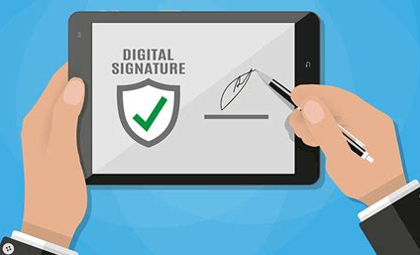
Digital Signatures
A digital signature is a cryptographic technique used to verify the authenticity and integrity of a digital message, document, or transaction.
It provides a way to ensure that the sender of a message is who they claim to be and that the message hasn't been altered during transmission.

Slide 12
Digital Signature How it works
The process starts with the generation of a pair of cryptographic keys: a private key and a public key. These keys are typically generated using algorithms such as RSA (Rivest-Shamir-Adleman) or DSA (Digital Signature Algorithm).
When a sender wants to sign a digital document or message, they use their private key to generate a unique digital signature for that specific content. The private key should be kept secret and known only to the owner.
The recipient, or anyone else interested in verifying the signature, can use the sender's public key to check the authenticity of the digital signature. If the signature is valid, it means that the document has not been altered since it was signed and that it was indeed signed by the owner of the private key.

Slide 13
Digital Signature How it works
Hashing: Digital signatures often involve the use of hash functions. A hash function takes an input (the document) and produces a fixed-size string of characters, which is a hash value. The hash value is unique to the specific content; even a tiny change in the content results in a vastly different hash value.
Combining the Signature and Hash: The digital signature is not typically applied directly to the entire document. Instead, the sender's private key is used to sign the hash value of the document. This makes the process more efficient and provides a fixed-size value to sign.
Public Key Infrastructure (PKI):
Digital signatures often rely on a Public Key Infrastructure (PKI) to manage and distribute public keys. Certificates issued by a trusted third party, known as a Certificate Authority (CA), help establish the link between a public key and its owner.

Slide 14
Digital Signatures
A digital signature is a specific type of electronic signature that requires the signer to authenticate their identity using a certificate-based digital ID.
The digital certificate is generally issued by an independent Certificate Authority (CA), which verifies the identity of the signer before issuing the certificate.
It is an encrypted code that a person, web site, or organization attaches to an electronic message to verify the identity of the message sender.
A digital signature is used to verify that the content of a message has not changed.

Slide 15
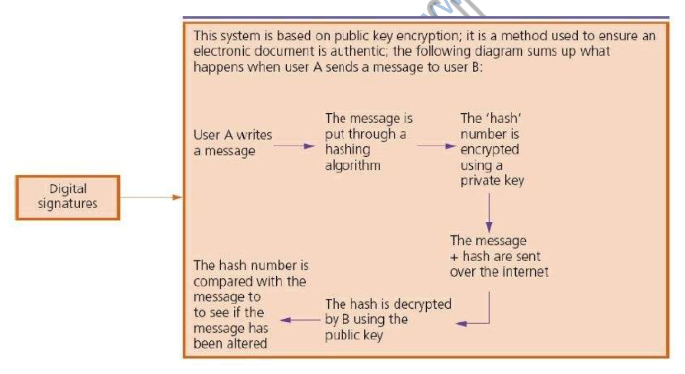
Digital Signatures

Slide 16
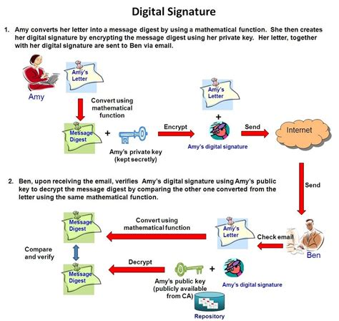
Digital Signatures
The code usually consists of the user’s name and a hash of all or part of the message.
Receivers of the message decrypt the digital signature by generating a new hash of the received message and compares it with one in the digital signature to ensure they match. Digital signatures often are used to ensure that an impostor is not participating in an Internet transaction. That is, digital signatures help to prevent e-mail forgery.

Slide 17
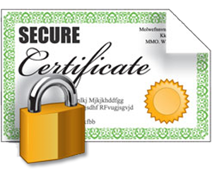
Digital Certificate A digital certificate is a cryptographic credential that verifies the identity of the certificate holder and enables secure communication over a computer network. is an electronic "password" that allows a person, organization to exchange data securely over the Internet using the public key infrastructure (PKI). Digital Certificate is also known as a public key certificate or identity certificate.

Slide 18
Digital Certificate Identity Verification: An individual, organization, or device applies for a digital certificate from a trusted Certificate Authority (CA). The CA verifies the applicant's identity before issuing the certificate. Public Key Binding: The digital certificate includes information such as the entity's name and a public key. Certificate Issuance: The CA issues the digital certificate with its digital signature, attesting to the authenticity of the certificate. Secure Communication: When engaging in secure online activities, such as accessing a secure website (via HTTPS), the website provides its digital certificate to the user's browser. The browser verifies the certificate's authenticity using the CA's public key, establishing a secure encrypted connection. Digital Signatures: Digital signatures on the certificate and other messages ensure the integrity of the information. Users can trust that the information has not been tampered with during transmission.

Slide 19
Digital Certificate Validity Period and Renewal: Digital certificates have a limited validity period to enhance security. The certificate holder needs to renew the certificate periodically to maintain secure communication. Revocation: In case of a compromise or if the certificate is no longer valid, the CA may revoke the certificate. Revocation information is made available through mechanisms like Certificate Revocation Lists (CRLs) or Online Certificate Status Protocol (OCSP).

Slide 20
Digital Certificate An individual, organization, or device applies for a digital certificate from a trusted Certificate Authority (CA). The CA verifies the applicant's identity before issuing the certificate. Following identity verification, the digital certificate will have information such as the entity's name and a public key, which binds the public key to the entity forms allowing for the verification of identities digitally. Once the Certificate Authority completes the verification process, it issues the digital certificate with the embedded digital signature, indicating the authenticity of the document.

Slide 21
Digital Certificate When conducting secure online activities, especially during web browsing, digital certificates come into play. Accessing a secure website through HTTPS, the website furnishes its digital certificate to the user's browser. The browser, in turn, meticulously verifies the certificate's authenticity using the CA's public key, before establishing a secure connection

Slide 22
Digital Certificate Digital certificates are commonly used in: Secure Web Browsing: When you connect to a secure website (https), the website's digital certificate ensures a secure and encrypted connection. Email Encryption: Digital certificates can be used to sign and encrypt emails, providing confidentiality and authenticity. Digital Transactions: Digital signatures and certificates play a role in securing online transactions, ensuring the integrity and authenticity of the exchanged information.

Slide 23
Digital Certificate Characteristics
Identification / Authentication: The person who we are communicating with are who they are
Confidentiality: The information within the message or transaction is kept confidential. It may only be read and understood by the intended sender and receiver
Integrity: The information within the message or transaction is not tampered accidentally or deliberately with en-route without all parties involved being aware of the tampering
Non-Repudiation: The sender cannot deny sending the message or transaction, and the receiver cannot deny receiving it
Access Control: Access to the protected information is only realized by the intended person or entity

Slide 24
Contents of a Digital Certificate
Subject Name - "subject" refers to the site represented by the cert.
Information about the certificate issuer/certificate authority (CA) - The CA is the body that issued and signed the certificate.
Serial number - this is the serial number assigned by the issuer to this certificate. Each issuer must make sure each certificate it issues has a unique serial number.
Validity period - certificates aren't meant to last forever. The validity period defines the period over which the certificate can still be deemed trustworthy.
Signature - This is the digital signature of the entire digital certificate, generated using the certificate issuer's private key
Signature algorithm - The cryptographic signature algorithm used to generate the digital signature (e.g. SHA-1 with RSA Encryption)
Public key information - Information about the subject's public key. This includes:
the algorithm (e.g. Elliptic Curve Public Key),
the key size (e.g. 256 bits),
the key usage (e.g. can encrypt, verify, derive), and
the public key itself

Slide 25

Quantum Cryptography
What is Quantum Cryptography?

Slide 26

What is Quantum Cryptography?
Quantum cryptography leverages principles of quantum mechanics to secure communication channels. Unlike classical cryptography, which relies on mathematical complexity, quantum cryptography uses the fundamental properties of quantum mechanics to achieve secure communication.
Quantum cryptography is a science that applies quantum mechanics principles to data encryption and data transmission so that data cannot be accessed by hackers – even by those malicious actors that have quantum computing of their own.
Quantum cryptography is different from traditional cryptographic systems in that it relies on physics, rather than mathematics, as the key aspect of its security model.

Slide 27
Purpose:
$6,789
quantum Key Distribution (QKD): The primary purpose of quantum cryptography is to enable secure key distribution through Quantum Key Distribution (QKD). QKD uses quantum properties to allow two parties to produce a shared random secret key, known only to them, which can then be used for conventional symmetric-key cryptography.
Secure Communication: Quantum cryptography aims to provide unconditional security for communication. It utilizes quantum properties, such as superposition and entanglement, to detect any eavesdropping attempts, ensuring that the security of the key exchange can be guaranteed.

Slide 28
Security
Quantum cryptography is a system that is completely secure against being compromised without the knowledge of the message sender or the receiver.
That is, it is impossible to copy or view data encoded in a quantum state without alerting the sender or receiver.
Quantum cryptography should also remain safe against those using quantum computing as well.
One of the best-known examples of quantum cryptography currently is Quantum Key Distribution (QKD), which provides a secure method for key exchange.
$6,789

Slide 29
How Does It Works?
Quantum cryptography, or quantum key distribution (QKD), uses a series of photons (light particles) to transmit data from one location to another over a fiber optic cable. By comparing measurements of the properties of a fraction of these photons, the two endpoints can determine what the key is and if it is safe to use.
The sender transmits photons through a filter (or polarizer) which randomly gives them one of four possible polarizations and bit designations: Vertical (One bit), Horizontal (Zero bit), 45 degree right (One bit), or 45 degree left (Zero bit).
The photons travel to a receiver, which uses two beam splitters (horizontal/vertical and diagonal) to “read” the polarization of each photon. The receiver does not know which beam splitter to use for each photon and has to guess which one to use.
Once the stream of photons has been sent, the receiver tells the sender which beam splitter was used for each of the photons in the sequence they were sent, and the sender compares that information with the sequence of polarizers used to send the key. The photons that were read using the wrong beam splitter are discarded, and the resulting sequence of bits becomes the key.
$6,789

Slide 30
Benefits of Quantum Cryptography
Security Based on Quantum Principles:
Quantum cryptography exploits the principles of quantum mechanics, such as the no-cloning theorem and the observer effect, to provide a level of security that is theoretically immune to certain types of attacks.
Quantum Key Distribution (QKD):
QKD ensures secure key exchange, as any attempt to intercept the quantum states being transmitted would inevitably disturb them, alerting the communicating parties to the presence of an eavesdropper.
Future-Proof Against Quantum Computers:
Quantum cryptography is often considered "quantum-safe" or "quantum-resistant" because it is not vulnerable to attacks by quantum computers. Traditional public-key cryptography, which relies on the difficulty of certain mathematical problems, could be broken by sufficiently powerful quantum computers.

Slide 31
Drawback of Quantum Cryptography
Practical Implementation Challenges:
Implementing quantum cryptography in real-world scenarios faces significant challenges, such as the need for specialized equipment, the sensitivity of quantum states to environmental conditions, and the limited range over which quantum entanglement can be maintained.
Limited Range:
Quantum communication systems, particularly those based on entanglement, have a limited range over which they can operate effectively. This can make it challenging to deploy quantum cryptography over long-distance communication channels.
Key Distribution Over Classical Channels:
While QKD enables the secure exchange of keys, the actual key distribution often relies on classical communication channels. If these classical channels are compromised, it could undermine the security of the key exchange.
Cost and Complexity:
The development and deployment of quantum cryptographic systems can be costly and complex. Specialized quantum hardware is required, and the technology is still in the early stages of commercialization.

Slide 32
Limitation of Quantum Cryptography
1
2
3
Changes in polarization and error rates.
Photons may change polarization in transit, which potentially increases error rates.
Range. The maximum range of quantum cryptography has typically been around 400 to 500 km, with the exception of Terra Quantum, as noted below.
Expense. Quantum cryptography typically requires its own infrastructure, using fiber optic lines and repeaters.
Number of destinations. It is not possible to send keys to two or more locations in a quantum channel.

Slide 33
SSL/TLS Encryption?
The two main protocols used to ensure security when using the internet are
Secure Sockets Layer (SSL) and Transport Layer Security (TLS); these are
both part of the transport layer
Although SSL is now considered outdated and has largely been replaced by TLS, it's still valuable to understand its key features and how it contributed to online security.

Slide 34
SSL/TLS Encryption?
The two main protocols used to ensure security when using the internet are
Secure Sockets Layer (SSL) and Transport Layer Security (TLS); these are
both part of the transport layer
Although SSL is now considered outdated and has largely been replaced by TLS, it's still valuable to understand its key features and how it contributed to online security.

Slide 35
SSL/TLS Encryption?
When a user logs onto a website, SSL encrypts the data – only the client’s computer and the web server are able to make sense of what is being transmitted.
Two other functions of SSL are data compression (reducing the amount of data being transmitted), and data integrity checks.
A user will know if SSL is being applied when they see the https protocol and/or the small green closed padlock.

Slide 36
Transport Layer Security (TLS)
Transport Layer Security (TLS) is a cryptographic protocol suite designed to secure communications over a computer network.
TLS ensures the privacy and integrity of data exchanged between applications, such as web browsers and servers, by providing encryption and authentication services.
It is often refered to as the TLS protocol suite

Slide 37
Transport Layer Security (TLS)
It is often referred to as the TLS protocol suite because it uses 2 different protocols
Handshake Protocol: The Handshake Protocol is used to establish a secure connection between a client and a server. The parties agree on cryptographic parameters, exchange keys, and authenticate each other and also the verification of digital certificates.
Record Protocol: The is responsible for breaking up large messages into smaller blocks, applying encryption and compression, and adding integrity checks through message authentication codes (MACs).
This protocol operates beneath the application layer and ensures the confidentiality and integrity of the transmitted data.

Slide 38
Transport Layer Security (TLS)
The TLS also use session resumption (sometimes called session caching”)
Session resumption allows a client and server to resume a previously established session without performing a complete new handshake.
Example:
If a client connects to a server and establishes a TLS session, both parties can negotiate to save the session parameters.
These parameters include the
session ID
cryptographic keys.
When the session resumes, if the client later wants to reconnect to the same server, it can present the saved session ID during the initial steps of the handshake. If the server still has the corresponding session parameters cached, the handshake can be abbreviated, significantly reducing the overhead of establishing a new secure connection.

Slide 39

How Does SSL/TLS Encryption Work?
A website must have an SSL/TLS certificate for their web server/domain name to use SSL/TLS encryption.
Once installed, the certificate enables the client and server to securely negotiate the level of encryption in the following steps:
The client contacts the server using a secure URL (HTTPS…).
The server sends the client its certificate and public key.
The client verifies this with a Trusted Root Certification Authority to ensure the certificate is legitimate.
The client and server negotiate the strongest type of encryption that each can support.
The client encrypts a session (secret) key with the server’s public key, and sends it back to the server.
The server decrypts the client communication with its private key, and the session is established.
The session key (symmetric encryption) is now used to encrypt and decrypt data transmitted between the client and server.

Slide 40
How Does SSL/TLS Encryption Work?
SSL/TLS uses both asymmetric and symmetric encryption to protect the confidentiality and integrity of data-in-transit.
Asymmetric encryption is used to establish a secure session between a client and a server, and symmetric encryption is used to exchange data within the secured session.
Both the client and server are now using HTTPS (SSL/TLS + HTTP) for their communication. Web browsers validate this with a lock icon in the browser address bar. HTTPS functions over Port 443.
Once the website is closed then the keys are discarded. When the website is open again then a new handshake is negotiated, and a new set of keys are generated.

Slide 41


THANK YOU!
August Bergqvist
Phone:
678-555-0134
Email:
bergqvist@treyresearch.com
Website:
http://www.treyresearch.net/

